Slide 1



نصل بكم إلى التميّز
Notes:
Greeting
Introduce yourself (name, position)
Thank the audience for their time
Subject of the presentation
Main sections (Agenda) we can add it as a slide

Slide 2


لمحة سريعة
أكثر من 200 خبير
+60 عميلاً
+800 مشروعاً
5 مكاتب إقليمية
نقدّم حلول تكنولوجيا المعلومات منذ 2006
Your challenge is our passion
Notes:
Offices in (Jordan, UAE, KSA, Oman, and Qatar)
99% Client Retention
100% Mission Critical Project success
Geographical reach (Middle east, Africa , and east Asia)
3 entrepreneurs, → 150+

Slide 3





































عملاؤنا
MODEE
Ministry of Justice
Ministry of Labor
Ministry of Water
Notes:
First two rows telecom
Clients' lifetime, engagement → average 10 years
Ooredoo 17 years, since the beginning till this moment
Virgin 14 years + we managed to launch in 7 different countries due to the trust
Been part of the Launch 7 telecom operators
We focus on telecom, but we work with different industries like (government, healthcare, NGOs, Tourism)
(In case they ask about Aramex: operators partner with logistic companies to deliver their products and services “Order fulfilment”)

Slide 4













شركاؤنا
Notes:
Microsoft: since the beginning we’re gold partenr as a service delivery
Odoo: our ERP platform
MicroBlink: Customer verification
Hyper pay: regionally payment famous gatway
Intaj: IT association umbrella in Jordan
Webengage: Customer journey partner
Omicron: workflow and business auomation
ABS: SAP distrubutor
Pengunin: IoT Partner
Mena Tech: Media partner
If we are talking to a potential partner (add a space for the new partner) → there is a space for you

Slide 5
حلول الذكاء الاصطناعي
AI Solutions

Slide 6





حلول الذكاء الاصطناعي
نماذج ووكلاء الذكاء الاصطناعي
AI Models & Agents
دورة حياة تطوير البرمجيات المدعومة بالذكاء الاصطناعي
AI-Powered SDLC
نظام استبدال التطبيقات القديمة بالذكاء الاصطناعي
AI Legacy Application Migrator
خدمات التحول الرقمي باستخدام الذكاء الاصطناعي
AI Transformation

Slide 7





حلول دورة حياة تطوير البرمجيات SDLC
دورة حياة تطوير البرمجيات
التكامل والإصدار
التصميم
إعداد قنوات التكامل والتوزيع المستمر CI/CD وخطوط النشر
وضع هيكلية النظام وتصميمه التفصيلي
الاختبار والتحقق
مرحلة التنفيذ
تحديد المتطلبات
اختبار الحل وضمان مطابقته للمتطلبات والمواصفات
تطبيق الحل وتطويره برمجياً
تعريف وتحليل متطلبات المشروع
Notes:
Accelerate Innovation with AI-Driven Software Development
Reimagine your software development lifecycle with intelligent automation at every step. Our cutting-edge AI-Enhanced SDLC Framework transforms traditional development into a seamless, adaptive, and ultra-efficient process — powered by a network of specialized AI agents.
🔍 From Requirements to Release — Intelligence All the Way
Each phase of your SDLC is guided by an expert AI agents:
AI-Driven Requirements Analyst: Extracts, structures, and refines business needs using multi-LLM requirement agent.
AI Architect & Design Agent: Generates system architecture and technical design blueprints by evaluating feasibility, scalability, and best practices taking into consideration organization’s constraints and design guidelines.
AI Solution Construction Agent: Constructs solution components using context-aware code AI agent.
AI Integrator & Release Manager: Automates API wiring, dependency resolution, and service orchestration using multi-agent CI/.CD.
AI QA & Verifier: Performs intelligent validation, test case generation/execution and reporting.
All these agents work collaboratively through a modular architectural fabric that leverages human in the loop and agent-to-agent (A2A) interoperability, shared context memory, and specialized models working in harmony — resulting in a fluid, adaptive development workflow.
💼 Why It Matters to Your Business
✅ 25-50% Faster Delivery
Automate routine tasks, reduce handoffs, and compress timelines without compromising quality.
✅ Superior Quality & Fewer Defects
Leverage AI-powered validation to catch errors earlier and improve code reliability.
✅ Cost Reduction
Cut down on redundant development cycles, testing efforts, and manual rework.
✅ Smarter Decisions, Backed by Data
Enable real-time decision-making and impact analysis powered by intelligent agents trained on vast industry datasets.
✅ Architecture/Coding based on Best Practices
Scale effortlessly with plug-and-play model integration, RAG-backed knowledge injection, and on-demand specialization for custom workflows.
✅ Security, Performance, Maintainable software
✅ Compliance
With the needed standards.

Slide 8
نظام استبدال التطبيقات القديمة بالذكاء الاصطناعي
التحديات التي نحلّها
عملية الاستبدال
ندرة الكفاءات المتخصصة
تقييم وتحليل الوضع الراهن
المخاطر السيبرانية
  نظام استبدال التطبيقات القديمة بالذكاء الاصطناعي
وضع خارطة الطريق والتحوّل
ارتفاع تكاليف الصيانة
الاختبار والإطلاق الآمن
طول مدة المشاريع
التحسين المستمر والمراقبة
الفوائد الرئيسية
تقليص زمن الاستبدال حتى 50%
خفض كبير في التكلفة الإجمالية
أمان أعلى وقابلية توسع أكبر مع امتثال للمعايير
الحفاظ على منطق العمل وقواعده أثناء التحديث
إمكانية بناء النظام الجديد وفق المعايير المطلوبة
تقليل التعقيد والاعتمادية على تقنيات قديمة

Slide 9






نماذج ووكلاء الذكاء الاصطناعي
نماذج ذكاء
اصطناعي متقدمة
التعلّم التكيُّفي
Advanced AI Models
Adaptive Learning
قابل للتخصيص ومتوافق مع المعايير
دعم قابل للتوسع
Customizable & Compliant
Scalable Support
تكامل سلس
جاهزية 24/7
Seamless Integration
24/7 Availability
إشراف بشري عند الحاجة
تقليل الأخطاء البشرية
الميزات الرئيسية
Human in the loop
Reduced Human Error
Notes:
We build AI agents integrate with enterprise systems to automate repetitive tasks, free teams for high-impact work, and continuously learn to improve performance.
SR, MBR, GB, UtB, L

Slide 10



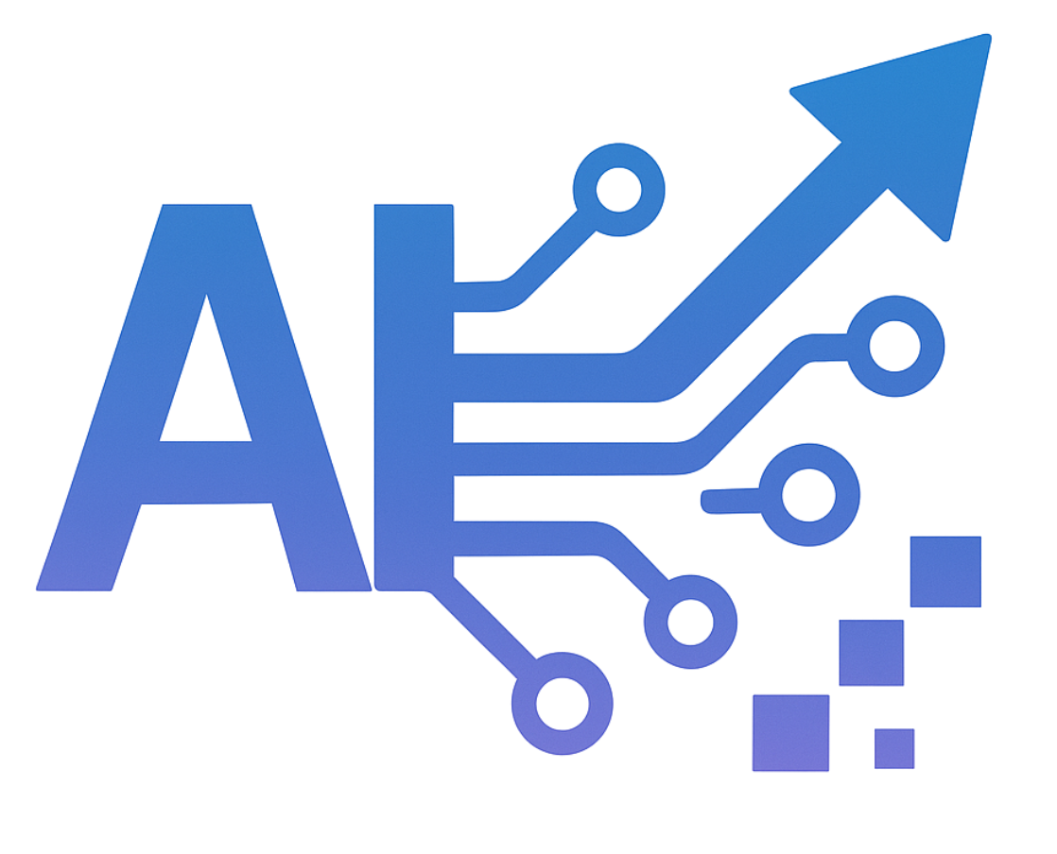




خدمات التحول الرقمي باستخدام الذكاء الاصطناعي
التقييم ووضع الاستراتيجية
01
07
تحديد الأهداف
تصميم الحل
02
06
استشارات البنية التحتية
مواءمة العمليات
03
05
04
هندسة البيانات وتعلم الآلة
نماذج مخصصة
Notes:
Deep industry experience, AI and technical knowledge, guide end2end

Slide 11
خدماتنا
Our Services

Slide 12



خدماتنا
خدمات التحول الرقمي
Digital Transformation
01
02
03
الخدمات التقنيّة المُدارة
الحلول المُخصّصة
Managed Services
Bespoke Solutions
Notes:
Deep industry experience, AI and technical knowledge, guide end2end

Slide 13





التحول الرقمي
الترحيل إلى السحابة وتحديث الأنظمة القديمة
أتمتة سير العمل لتسريع الوصول إلى السوق
تكامل واجهات البرمجة APIs ورقمنة العمليّات
إعادة تصميم سير العمل لرفع القيمة الرقمية وتعزيز تجربة العميل
دمج الأنظمة الرقمية في جميع العمليات المؤسسية
Notes:
Deep industry experience, AI and technical knowledge, guide end2end

Slide 14
الحلول المصممة خصيصًا
برمجيات مصممة خصيصًا لتناسب تفرُّد العمليّات التجارية
تكامل سلس مع الأنظمة القائمة وواجهات البرمجة (APIs)
نماذج أولية سريعة وتسليم تدريجي (Agile / DevOps)
هيكلية معيارية مرنة قابلة للتطوير والتوسّع المستقبلي
خيارات تعاون مرنة: تسليم متكامل(Turnkey) أو تعزيز فرق العمل (Staff Augmentation)
Notes:
Deep industry experience, AI and technical knowledge, guide end2end

Slide 15
الخدمات التقنيّة المُدارة
شراكة عمل حقيقية
Same-boat business model
01
02
منهجية Triple Es الخاصة بنا
LeadingPoint Triple Es Methodology
03
بنية جوهرية تضمن نجاح المهام الحيوية
The Mission-Critical DNA
Notes:
Why leading point
We at Leading Point, we took the Managed Services to the next level by providing Same-boat Business Model, Triple E’s methodology, and Mission-critical DNA

Slide 16





الخدمات التقنيّة المُدارة
الاستشارات في مجال الأعمال
أتمتة وضمان جودة العمليات
القيمة المضافة
إدارة شاملة لتجربة المنتجات
تحليلات متقدمة ورؤى قابلة للتنفيذ
حلول جاهزة وسريعة التطبيق
Notes:
As a Telecom IT Service Providers for 16 years, Leading Point putting all their experience and knowledge in order to provide the following value-added services to the Managed Services engagements

Slide 17
القطاعات التي نخدمها
Industries We Serve

Slide 18





القطاعات التي نخدمها
الخدمات اللوجستية
القطاع الصحي
القطاع الحكومي
التقنية المالية
(الفنتك)
الاتصالات
التحول بالذكاء الاصطناعي
التحول الرقمي
حلول برمجية مخصصة
الخدمات التقنيّة المُدارة
نظام استبدال التطبيقات القديمة بالذكاء الاصطناعي
دورة حياة تطوير البرمجيات المدعومة بالذكاء الاصطناعي

Slide 19
القطاعات التي نخدمها
الخدمات اللوجستية
القطاع الصحي
القطاع الحكومي
التقنية المالية
(الفنتك)
الاتصالات
التحول بالذكاء الاصطناعي
التحول الرقمي
حلول برمجية مخصصة
IT Managed Services
AI Migrator
AI-Powered SDLC
Notes:
AI Transformation Services (All Sectors)
Differentiation: LP’s AI Transformation Services are designed around your specific business goals — we don’t deploy off-the-shelf AI. Instead, we engineer tailored AI capabilities that integrate into your core workflows, enabling intelligent growth, enhanced decision-making, and measurable efficiency gains. Our approach combines process automation, data-driven insights, customer experience enhancement, and secure operational workflows, ensuring AI becomes a core enabler of innovation.
Use Case:
Organizations across telecom, healthcare, government, fintech, and logistics partner with LP to:
- Pinpoint high-impact AI opportunities that deliver measurable ROI.
- Build and integrate custom AI models or AI agents to fit operational workflows.
- Automate routine processes, optimize resource allocation, and enable predictive analytics.
- Modernize legacy systems without disrupting existing operations.
- Scale AI adoption securely, meeting compliance and governance standards.
The result is an AI-enabled organization with greater speed, precision, and foresight — ready to unlock new business opportunities, reduce costs, and deliver better services and products.

Slide 20
القطاعات التي نخدمها
الخدمات اللوجستية
القطاع الصحي
القطاع الحكومي
التقنية المالية
(الفنتك)
الاتصالات
التحول بالذكاء الاصطناعي
التحول الرقمي
حلول برمجية مُخصصّة
الخدمات التقنيّة المُدارة
AI Migrator
AI-Powered SDLC
Notes:
Digital Transformation (All Sectors)
Differentiation: LP’s Digital Transformation services go beyond technology deployment — we rethink and re-engineer your business processes to fully leverage modern digital capabilities. We combine strategic consultation, process redefinition, and technology enablement to create measurable improvements in efficiency, customer experience, and long-term innovation.
Use Case:
- Organizations in telecom, healthcare, government, fintech, and logistics partner with LP to:
- Assess current processes and systems, identifying inefficiencies and opportunities.
- Develop clear, actionable transformation strategies aligned with business goals.
- Redefine and optimize workflows to maximize automation, data-driven decision-making, and customer engagement.
- Implement integrated digital platforms, analytics, and tools that unify data and operations.
- Drive change management to ensure smooth adoption and sustained value.
- The result is an agile, data-enabled organization that adapts quickly to market changes, fosters innovation, and delivers consistently improved outcomes for customers, citizens, or partners.

Slide 21
القطاعات التي نخدمها
الخدمات اللوجستية
القطاع الصحي
القطاع الحكومي
التقنية المالية
(الفنتك)
الاتصالات
التحول الرقمي
التحول بالذكاء الاصطناعي
حلول برمجية مُخصصّة
الخدمات التقنيّة المُدارة
نظام استبدال التطبيقات القديمة بالذكاء الاصطناعي
AI-Powered SDLC
Notes:
Bespoke Software (All Sectors)
Differentiation: LP’s Bespoke Software is built entirely around your specific objectives, workflows, and preferences. We deliver complete ownership, seamless integration with your existing systems, and ongoing support — ensuring the solution remains secure, scalable, and fully aligned with your evolving needs.
Use Case:
Organizations across telecom, healthcare, government, fintech, and logistics engage LP to:
- Design and develop custom software from the ground up, matching your exact requirements.
- Fully integrate the solution with existing systems, platforms, and hardware.
- Retain complete ownership of the software, eliminating recurring licensing costs.
- Ensure security, scalability, and flexibility to adapt to future growth.
- Benefit from continuous post-deployment support, enhancements, and updates.
The result is a future-proof, high-performance system that gives organizations a competitive advantage while delivering long-term cost efficiency and eliminating the compromises of generic solutions.

Slide 22
القطاعات التي نخدمها
الخدمات اللوجستية
القطاع الصحي
القطاع الحكومي
التقنية المالية
(الفنتك)
الاتصالات
Digital Transformation
حلول برمجية مُخصصّة
AI Transformation
الخدمات التقنيّة المُدارة
نظام استبدال التطبيقات القديمة بالذكاء الاصطناعي
دورة حياة تطوير البرمجيات المدعومة بالذكاء الاصطناعي
Notes:
IT Managed Services (Full-Service IT Ownership, All Sectors)
Differentiation: Unlike traditional outsourcing that focuses on staffing or generic system upkeep, LP’s IT Managed Services takes complete responsibility for the performance and evolution of a client’s IT platform or service. We own the end-to-end delivery — from upgrades, integrations, and testing to rollout, optimization, and problem resolution — while working with the client on clearly defined KPIs and business outcomes. The client doesn’t manage resources; they see results.
Use Case:
A client shifts the operational responsibility of a mission-critical application to LP — for example, a dealer app in telecom, a hospital EMR in healthcare, or a citizen portal in government. LP’s team:
- Manages continuous upgrades and feature rollouts.
- Integrates third-party components and ensures compatibility.
- Conducts rigorous testing before deployment.
- Monitors performance and proactively resolves issues.
- Aligns every activity with agreed KPIs (e.g., uptime, transaction success rates, user satisfaction).
This model removes the operational burden from the client, ensuring the service is always available, secure, optimized, and aligned with evolving business goals — without the client needing to track headcount or technical workflows.

Slide 23
القطاعات التي نخدمها
الخدمات اللوجستية
القطاع الصحي
القطاع الحكومي
التقنية المالية
(الفنتك)
الاتصالات
Digital Transformation
الخدمات التقنيّة المُدارة
Bespoke Software
AI Transformation
نظام استبدال التطبيقات القديمة بالذكاء الاصطناعي
دورة حياة تطوير البرمجيات المدعومة بالذكاء الاصطناعي
Notes:
AI Migrator (All Sectors)
Differentiation: LP’s AI Migrator accelerates and de-risks the migration of legacy systems to modern, scalable platforms by combining advanced AI automation with deep domain expertise. Unlike traditional migration approaches that are manual, time-consuming, and error-prone, AI Migrator delivers faster transitions, minimal disruption, and higher data accuracy.
Use Case:
Organizations in telecom, healthcare, government, fintech, and logistics use LP’s AI Migrator to:
- Analyze legacy environments and identify dependencies, bottlenecks, and risks before migration.
- Automate code and data transformation, reducing manual rework and human error.
- Preserve data integrity and compliance during system migration.
- Integrate modern features and enhancements during the migration process rather than after.
- Enable seamless cutover to the new environment with minimal downtime.
The result is a fast, secure, and low-risk modernization that keeps operations running smoothly while unlocking the benefits of new technologies, improved performance, and long-term scalability.

Slide 24
القطاعات التي نخدمها
الخدمات اللوجستية
القطاع الصحي
القطاع الحكومي
التقنية المالية
(الفنتك)
الاتصالات
Digital Transformation
نظام استبدال التطبيقات القديمة بالذكاء الاصطناعي
IT Managed Services
Bespoke Software
AI Transformation
دورة حياة تطوير البرمجيات المدعومة بالذكاء الاصطناعي
Notes:
AI-Powered SDLC (All Sectors)
Differentiation: LP’s AI-Powered SDLC integrates artificial intelligence at every stage of the software development lifecycle — from requirements gathering and design to coding, testing, deployment, and ongoing optimization. This full-lifecycle AI infusion ensures better alignment with business goals, faster delivery, higher quality, and reduced risk.
Use Case:
Organizations in telecom, healthcare, government, fintech, and logistics use LP’s AI-Powered SDLC to:
- Capture and analyze requirements using AI to identify gaps, prioritize features, and align with KPIs.
- Generate optimized architectures and workflows tailored to project needs.
- Automate code generation for faster, more consistent development.
- Conduct AI-driven testing and quality checks, detecting defects and performance issues early.
- Perform compliance and security validation throughout development.
- Manage automated, low-risk deployments with post-launch AI monitoring and improvement recommendations.
The result is a faster, smarter, and more reliable software delivery process that consistently meets deadlines, quality standards, and business objectives.

Slide 25
القطاعات التي نخدمها
SendPoint
SurveyPoint
SalesPoint
WalletPoint
VoC
CatalogPoint
الخدمات اللوجستية
القطاع الصحي
القطاع الحكومي
التقنية المالية
(الفنتك)
الاتصالات
DeliveryPoint
MarketPoint
SelfPoint
NetCell
VisionPoint
PeoplePoint
ConvoAI
ViewPoint
L2 Support Agent
Digital Transformation
نظام استبدال التطبيقات القديمة بالذكاء الاصطناعي
IT Managed Services
Bespoke Software
AI Transformation
دورة حياة تطوير البرمجيات المدعومة بالذكاء الاصطناعي
Notes:
AI-Powered SDLC (All Sectors)
Differentiation: LP’s AI-Powered SDLC integrates artificial intelligence at every stage of the software development lifecycle — from requirements gathering and design to coding, testing, deployment, and ongoing optimization. This full-lifecycle AI infusion ensures better alignment with business goals, faster delivery, higher quality, and reduced risk.
Use Case:
Organizations in telecom, healthcare, government, fintech, and logistics use LP’s AI-Powered SDLC to:
- Capture and analyze requirements using AI to identify gaps, prioritize features, and align with KPIs.
- Generate optimized architectures and workflows tailored to project needs.
- Automate code generation for faster, more consistent development.
- Conduct AI-driven testing and quality checks, detecting defects and performance issues early.
- Perform compliance and security validation throughout development.
- Manage automated, low-risk deployments with post-launch AI monitoring and improvement recommendations.
The result is a faster, smarter, and more reliable software delivery process that consistently meets deadlines, quality standards, and business objectives.

Slide 26
منتجاتنا لقطاع الاتصالات
SendPoint
SurveyPoint
SalesPoint
WalletPoint
VoC
CatalogPoint
الخدمات اللوجستية
القطاع الصحي
القطاع الحكومي
التقنية المالية
(الفنتك)
الاتصالات
DeliveryPoint
MarketPoint
SelfPoint
NetCell
VisionPoint
PeoplePoint
ConvoAI
ViewPoint
L2 Support Agent
Notes:
CatalogPoint: A telecom operator uses CatalogPoint to create plans and bundles for its subscribers.
ConvoAI: A telecom operator uses ConvoAI to provide omnichannel customer support via chat, WhatsApp, and web, guaranteeing consistent, high-quality responses to customer issues regardless of the channel.
DeliveryPoint: A telecom operator uses DeliveryPoint to manage the distribution of devices from central warehouses to multiple regional retail outlets.
IT Support AI Agent (L2): A telecom operator uses the IT Support AI Agent for Level 2 technical support, ensuring consistent, accurate guidance on complex system issues, integrations, and configurations.
MarketPoint: A telecom operator uses MarketPoint to run an eShop marketplace for its customers to purchase plans, Devices, and SIM cards.
NetCell: A telecom operator uses NetCell to monitor multi-vendor 2G/3G/4G/5G networks in real time, detect service degradation, pinpoint root causes, and optimize performance before customers experience disruptions.
PeoplePoint: A telecom company uses PeoplePoint as an employee super app, enabling staff to check schedules, request leave, and receive company updates.
SalesPoint: A telecom operator uses SalesPoint to manage its entire dealer and distributor network, automate complex commission calculations, process voucher and e-Top Up transactions, and monitor sales performance through real-time analytics.
SelfPoint: A telecom operator uses SelfPoint to enable customers to top up, pay bills, and request service changes through a self-service mobile app.
SendPoint: A telecom operator uses SendPoint to design, personalize, and deliver large-scale customer campaigns across SMS, email, WhatsApp, and in-app channels, with AI optimizing delivery time, language, and channel for each recipient."
SurveyPoint: "A telecom operator uses SurveyPoint to trigger automated service satisfaction surveys after issue resolution in ConvoAI, feeding results back into the support quality dashboard.
A telecom operator uses SurveyPoint to launch post-service surveys linked directly to KPIs like NPS and customer retention, with AI analyzing sentiment and triggering alerts when satisfaction drops."
ViewPoint: A telecom operator uses ViewPoint to manage customers & subscriptions, track customer orders, and handle support tickets in one centralized CRM.
VisionPoint: A mobile operator uses VisionPoint for e-KYC during SIM activation, scanning the customer’s ID to extract information and verify that they are a real person through liveness detection.
VoC (Voice of Customer): A telecom operator uses VoC to collect feedback after a shop visit, analyzing sentiments to improve service quality.
WalletPoint: A telecom operator uses WalletPoint to provide their customers with eWallet solution where they can do remittance and digital payments.

Slide 27
منتجاتنا لقطاع التقنية المالية (الفنتك)
SendPoint
SurveyPoint
SalesPoint
WalletPoint
VoC
CatalogPoint
الخدمات اللوجستية
القطاع الصحي
القطاع الحكومي
التقنية المالية
(الفنتك)
الاتصالات
DeliveryPoint
MarketPoint
SelfPoint
NetCell
VisionPoint
PeoplePoint
ConvoAI
ViewPoint
L2 Support Agent
Notes:
ConvoAI: A bank uses ConvoAI to offer 24/7 account support, ensuring all customers receive accurate, consistent, and compliant responses to financial queries across mobile and web.
IT Support AI Agent (L2): A fintech company uses the IT Support AI Agent to assist IT teams with diagnosing and resolving customer issues related to the mobile app, delivering uniform, quick, and high-quality solutions every time.
PeoplePoint: A bank uses PeoplePoint to streamline internal approvals, announcements, and staff self-service in one app.
SendPoint: A bank uses SendPoint to run secure, personalized marketing and compliance notifications, with predictive delivery analytics minimizing failed sends and optimizing cost."
SurveyPoint: A bank uses SurveyPoint to gather customer feedback on new mobile banking features, with KPI tracking aligning responses to product performance goals."
VisionPoint: A bank uses VisionPoint to instantly verify new customers opening an account via mobile app by scanning their ID and confirming liveness.
VoC (Voice of Customer): A bank uses VoC to collect customer feedback on a newly launched mobile app feature, analyzing their responses and sentiments to measure their satisfaction..
WalletPoint: A fintech company uses WalletPoint to provide their customers with eWallet solution where they can do remittance and digital payments.

Slide 28
منتجاتنا للقطاع الحكومي
SendPoint
SurveyPoint
SalesPoint
WalletPoint
VoC
CatalogPoint
الخدمات اللوجستية
القطاع الصحي
القطاع الحكومي
التقنية المالية
(الفنتك)
DeliveryPoint
MarketPoint
SelfPoint
الاتصالات
NetCell
VisionPoint
PeoplePoint
ConvoAI
ViewPoint
L2 Support Agent
Notes:
ConvoAI: A municipality uses ConvoAI as a digital citizen service desk to guide users through applications and answer questions with uniform, reliable responses.
NetCell: An intelligence agency uses NetCell to monitor and maintain theirs network and data services ensuring uninterrupted coverage.
PeoplePoint: A ministry deploys PeoplePoint so employees can complete HR requests, view policies, and receive official communications.
SendPoint: A municipality uses SendPoint to deliver reminders for license renewals, automatically triggered when a citizen’s record in the government portal is within 30 days of expiry.
SurveyPoint: A public sector agency uses SurveyPoint to measure citizen satisfaction with online services through surveys, integrating results into operational dashboards to guide policy adjustments.
VisionPoint: A government agency uses VisionPoint to enable citizens to complete transactions through government web portals or mobile apps by scanning their ID, extracting details, and verifying their identity with liveness detection.
VoC (Voice of Customer): A municipality uses VoC to measure citizen satisfaction with new online tax payment services through their online interactions with social media pages or hotline calls.

Slide 29
منتجاتنا للقطاع الصحي
SendPoint
SurveyPoint
SalesPoint
WalletPoint
VoC
CatalogPoint
القطاع الصحي
الخدمات اللوجستية
القطاع الحكومي
التقنية المالية
(الفنتك)
DeliveryPoint
MarketPoint
SelfPoint
الاتصالات
NetCell
VisionPoint
PeoplePoint
ConvoAI
ViewPoint
L2 Support Agent
Notes:
ConvoAI: A hospital uses ConvoAI to handle appointment bookings, lab results inquiries, and patient FAQs with the same level of accuracy and quality across all touchpoints.
PeoplePoint: A hospital uses PeoplePoint for internal communication, allowing doctors and nurses to access schedules and training materials from their mobile devices.
SendPoint: A hospital uses SendPoint to send multilingual, AI-personalized health campaigns, appointment reminders, and wellness content while tracking engagement and delivery performance in real time.
SurveyPoint: A hospital uses SurveyPoint to send post-visit surveys to collect patient experience whose results automatically update patient satisfaction metrics.
VisionPoint: A hospital uses VisionPoint to verify a patient’s ID during online appointment booking, ensuring accurate records and preventing impersonation.
VoC (Voice of Customer): A clinic uses VoC to measure patient satisfaction with new mobile reservation app through their online interactions with social media pages or hotline calls.
L2 Support Agent: A hospital uses the IT Support AI Agent to assist IT teams with diagnosing and resolving customer issues related to the mobile app, delivering uniform, quick, and high-quality solutions every time.

Slide 30
منتجاتنا لقطاع الخدمات اللوجستية
SendPoint
SurveyPoint
SalesPoint
WalletPoint
VoC
CatalogPoint
القطاع الصحي
القطاع الحكومي
الخدمات اللوجستية
التقنية المالية
(الفنتك)
DeliveryPoint
MarketPoint
SelfPoint
الاتصالات
NetCell
VisionPoint
PeoplePoint
ConvoAI
ViewPoint
L2 Support Agent
Notes:
ConvoAI: A logistics company uses ConvoAI to allow customers to track shipments, change delivery preferences, and resolve delivery issues with consistent, professional responses.
DeliveryPoint: A logistics provider uses DeliveryPoint to coordinate last-mile deliveries for high-value goods, integrating GPS tracking and proof of delivery.
IT Support AI Agent (L2): A logistics provider uses the IT Support AI Agent to troubleshoot warehouse management system errors, providing detailed, standardized instructions to resolve them.
PeoplePoint: A logistics firm uses PeoplePoint to connect warehouse teams and drivers with management for updates, task assignments, and approvals.
SendPoint: A logistics provider uses SendPoint to trigger event-based shipment updates, promotional offers, and customer notifications, with AI adapting content and timing for higher engagement.
SurveyPoint: A logistics provider uses SurveyPoint to monitor delivery satisfaction and operational efficiency, with automated alerts for negative sentiment spikes in specific regions."
VisionPoint: A logistics company uses VisionPoint to verify the identity of customers receiving high-value or sensitive shipments by scanning their ID at the delivery point and confirming authenticity in real time.
VoC (Voice of Customer): A logistics provider uses VoC to collect delivery experience ratings from different channels and measure customer sentiments regarding delivery service.

Slide 31
التقنيات
Technologies

Slide 32























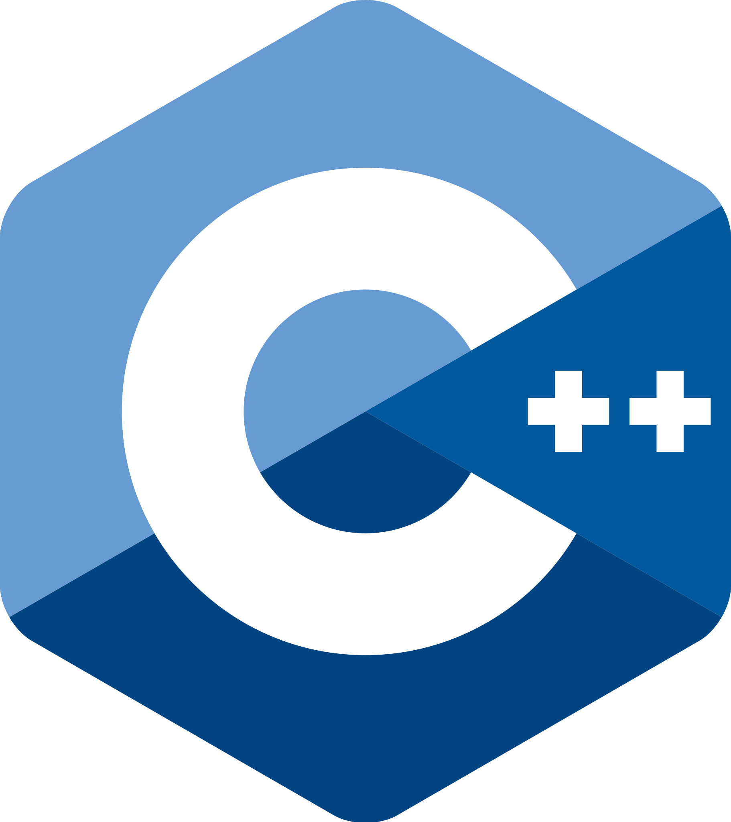


















التقنيات
Web
Mobile
Platforms
JavaScript
HTML
Typescript
Python
Vue JS
php
Kotlin
Objective-C
Swift
Flutter
WordPress
Odoo
Angular
jQuery
React
NodeJS
ionic
.NET MVC
Java
Xamarin
React Native
Moodle
Magento
Backend
Database
DevOps
.NET Core
C++
Java
Python
.NET
MS SQL
Redis
MySQL
Mongo DB
Azure DevOps
JIRA
Quality
Postgres
SQLite
elastic
Azure SQL
Jenkins
ELK Stack
Selenium
Appium
Katalon
JMeter
Postman
Cucumber
Notes:
Leading Point always strive to have the latest and trending technologies in all Areas
Currently we are using more that 50+ technologies

Slide 33






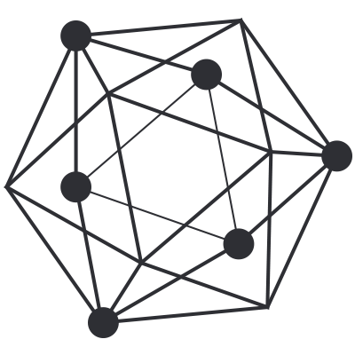

التقنيات الصاعدة
Emerging Technologies
Artificial Intelligence
Cognitive Services
ML .NET
Tensor Flow
ML Kit
Blockchain
Uniscrow
ERC 20
Hyperledger
Ethereum
Notes:
We recently established Leading Point R&D Department to keep improving our products and to enrich them with the emerging technologies like AI & Blockchain.

Slide 34








رحلة تحوّلكم الرقمي تبدأ معنا اليوم
مكتب الإمارات
مكتب قطر
مكتب السعودية
مكتب عُمان
مكتب الأردن
DD-14-116-007, WeWork Hub71, floor 14, Al Khatem Tower, Abu Dhabi, United Arab Emirates
Building-6 Area-80 Street-910 QATAR
8479 Al Mashaf, 3713Ar Rabie Dist, 13316, Riyadh, KSA
2749 23rd July St, Muscat 130, Oman
Wasfi At-Tall St., 90, Amman, Jordan
P.O. Box 3053, Amman 11953
+971 50 596 3477
+974 512 514 01
+966 57 200 1008
+968 77 050 750
+962 79 518 4010
info@leading-point.com
info@leading-point.com
info@leading-point.com
info@leading-point.com
info@leading-point.com

